Slide 1
Main figures

Slide 2
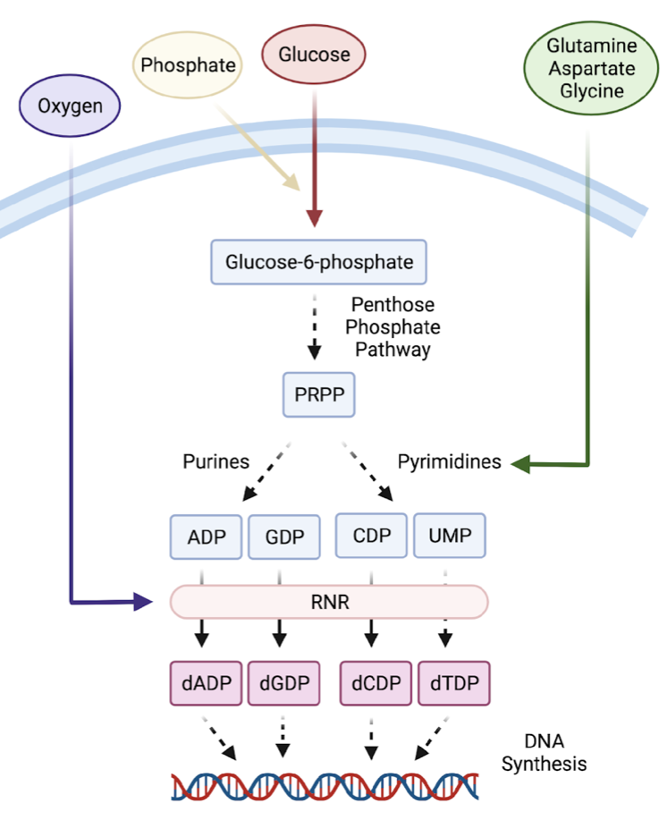
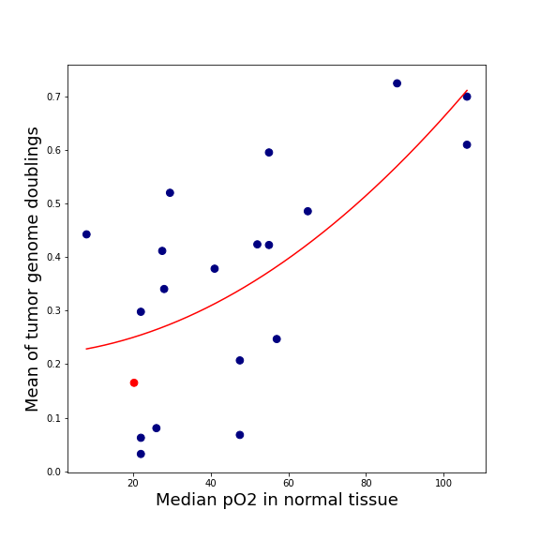
Nucleobases - Integrators of metabolic state
Lung
Brain
R²=0.457
Notes:
The cell needs extracellular resources to synthesize dNTPs, it needs PO4, Glucose and AAs. Also RNR, the key enzyme that mediates the synthesis of dNTPs, requires O2. Without O2, it slows down considerably.
When we look at the average O2 partial pressure recorded in various normal tissues (x-axis), and compare them to the incidence of WGD in cancers from the respective TT, we see that they are correlated. → giving rise to the idea that The more DNA a cell needs to replicate, the more its replication rate should suffer from suboptimal O2 concentrations.

Slide 3
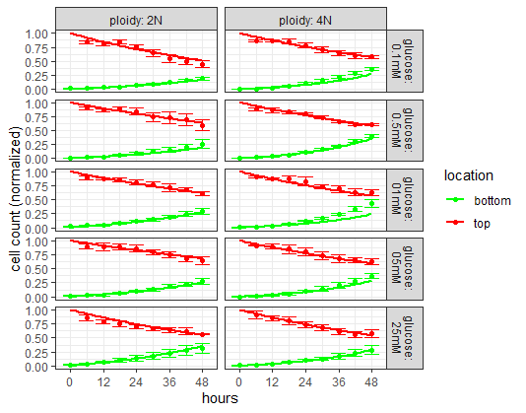
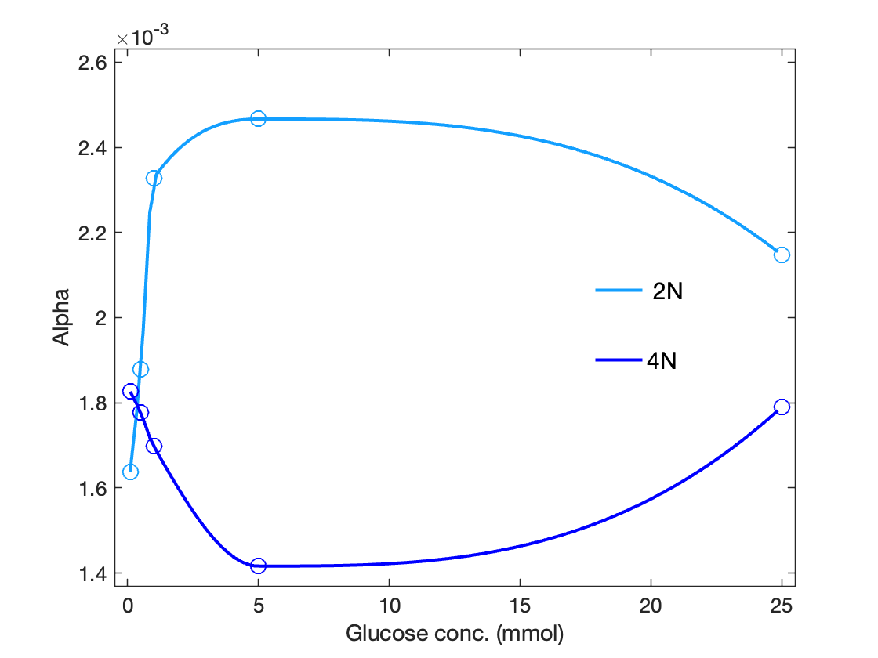
Migration assay: proof of concept results
Data from preliminary experiment (to be optimised)
Fitted model to cell counts from top/bottom of well
2) α(G_{t} ) found from fitting (results to be update pending experimental protocol optimisation).

Slide 4
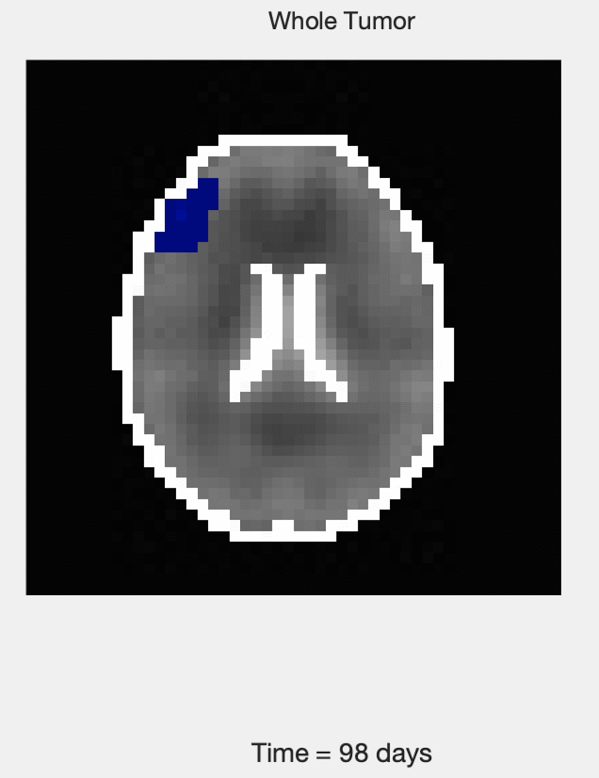
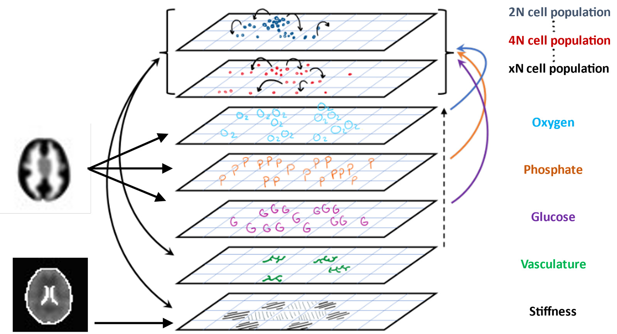
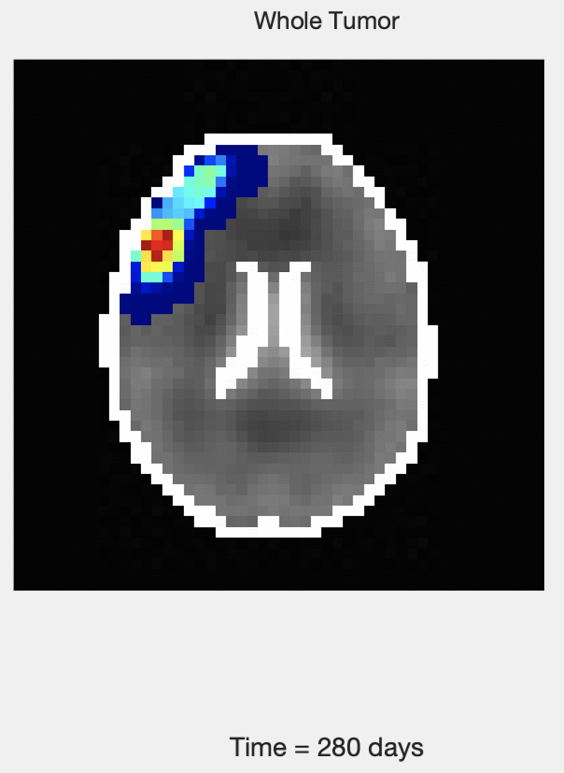
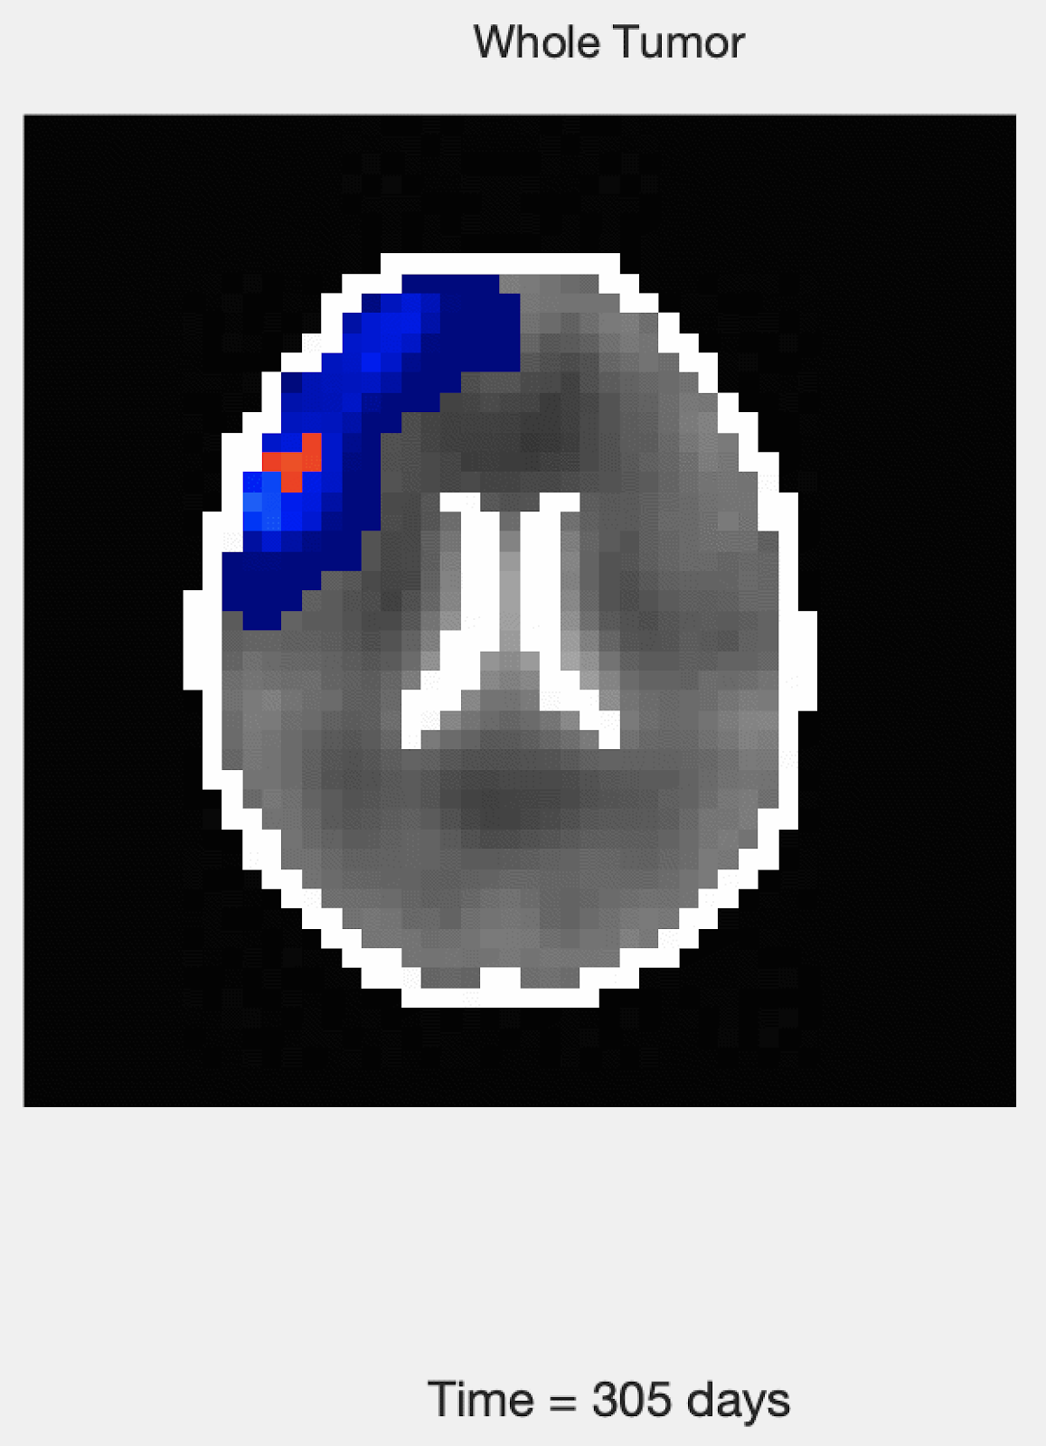
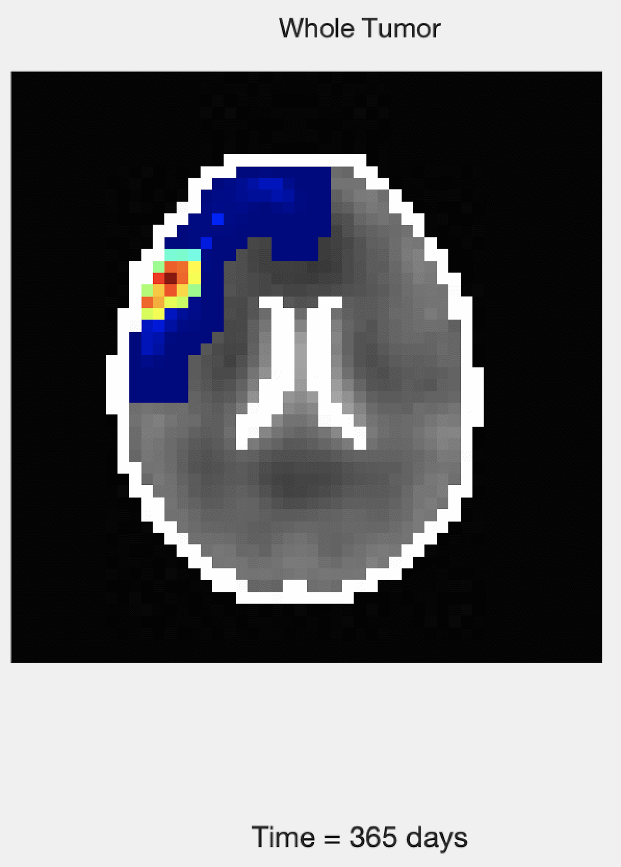
The S3MB Model Stochastic State-Space Model of the Brain: Model Elements
Aim 1 estimated cell parameters

Slide 5

The S3MB Model Stochastic State-Space Model of the Brain: Model Rules
Define each Voxel State = {S, O, P, G, V, N(1), N(2), …, D,K}
Update each of state space variables over time. Some key features
Resource Utilization
Cell Death and Division based on resources and K (carrying capacity)
Cell type conversion based on resources
Stochastic migration to neighboring voxels based on resources and stiffness
Stochastic recruitment and elimination of vasculature in voxels based on cell activity and therapy conditions
Discretize space into voxels

Slide 6
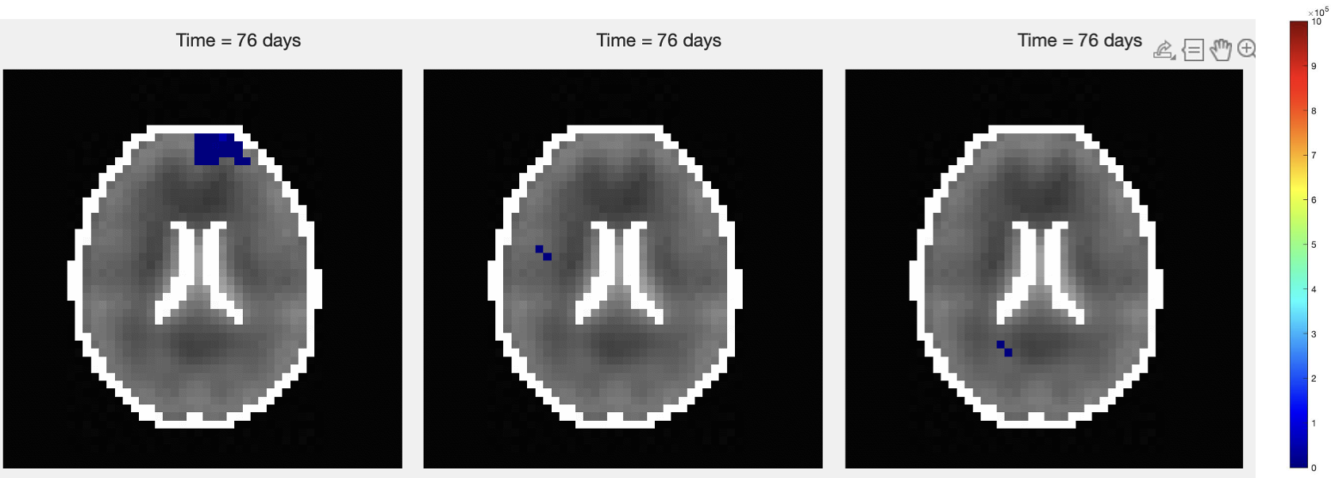
The S3MB Model Stochastic State-Space Model of the Brain: Model Implementation
We implemented the model in 2D and were able to model GBM growth and progression in the brain under a large variety of scenarios. Each 365 simulation takes only a few seconds.
Notes:
our preliminary data suggests that the availability of metabolic substrates in the environment (e.g. glucose, phosphate, oxygen) drives different cell fate decisions (e.g. proliferate, migrate or die) in cancer cells of different ploidy.

Slide 7
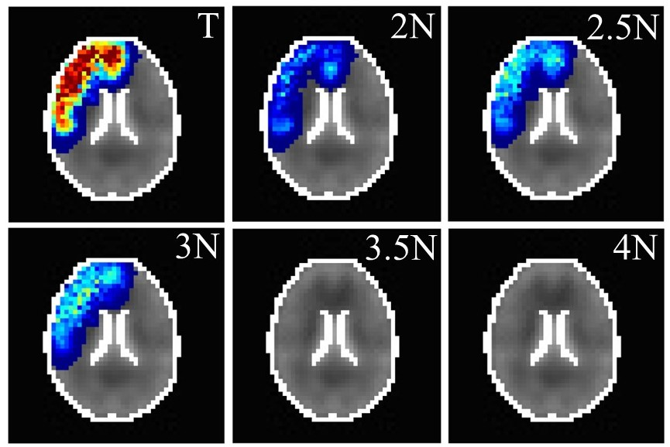
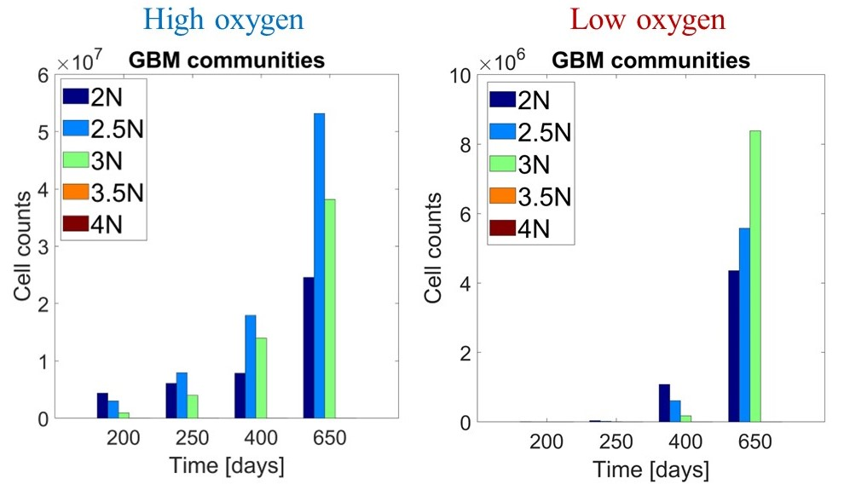
The S3MB Model Stochastic State-Space Model of the Brain: Model Capabilities
Evolution of cells communities with different ploidy distribution in different conditions

Slide 8
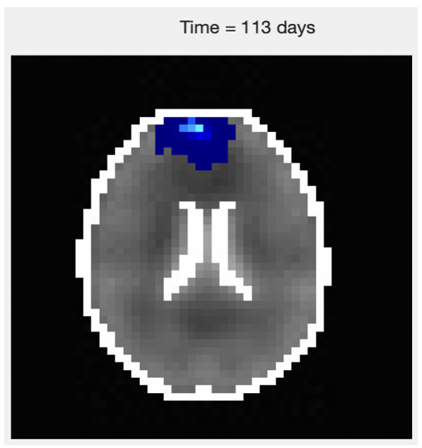
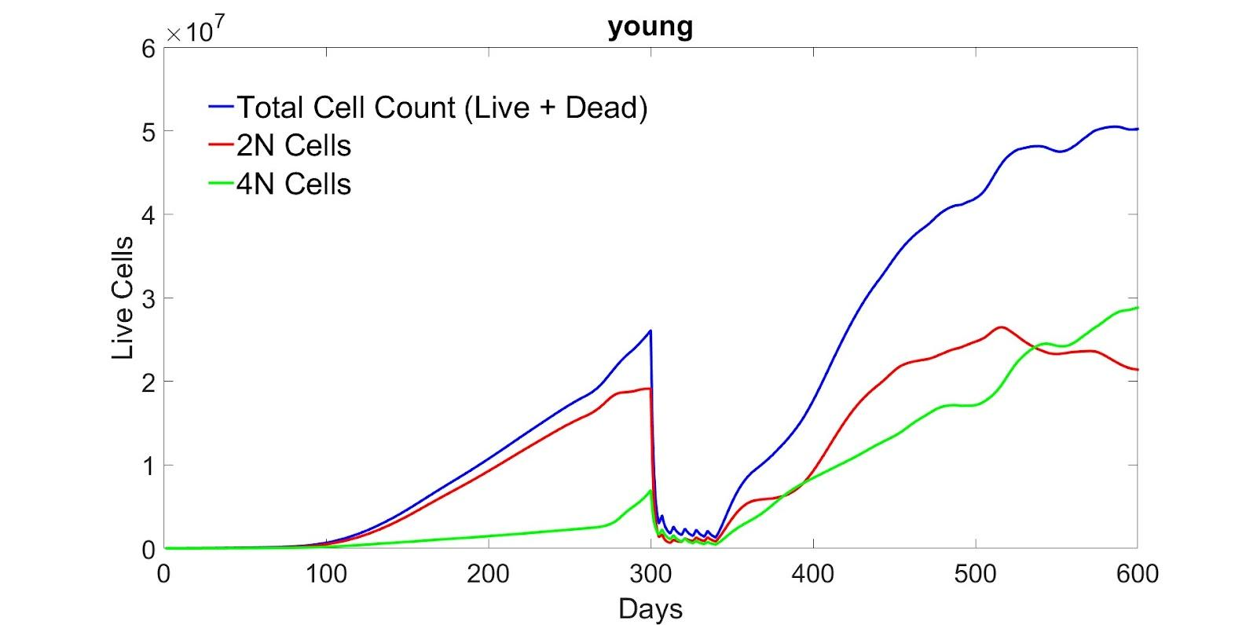
The S3MB Model Stochastic State-Space Model of the Brain: Model Capabilities
Simulating Radiation Treatment: 60 Gy in 2-Gy fractions delivered over 6 weeks

Slide 9
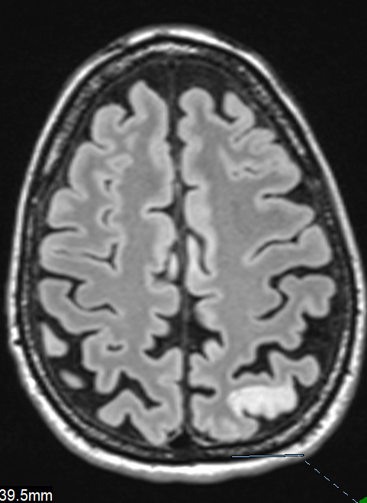
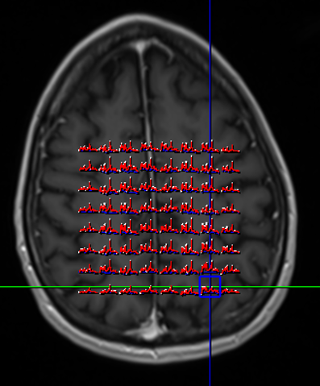
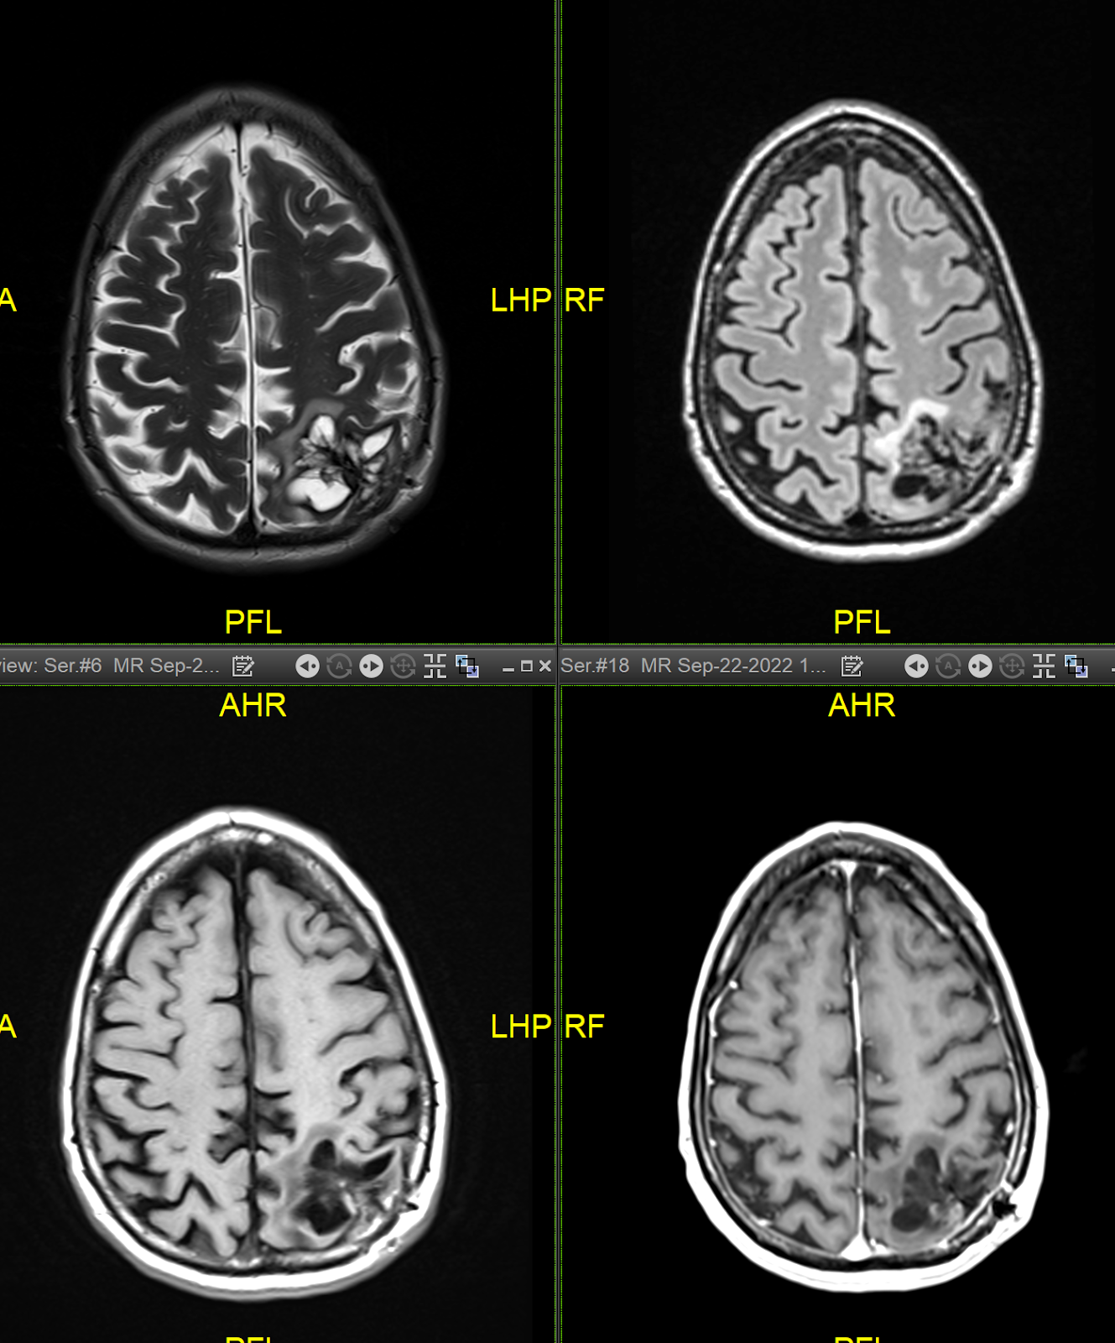
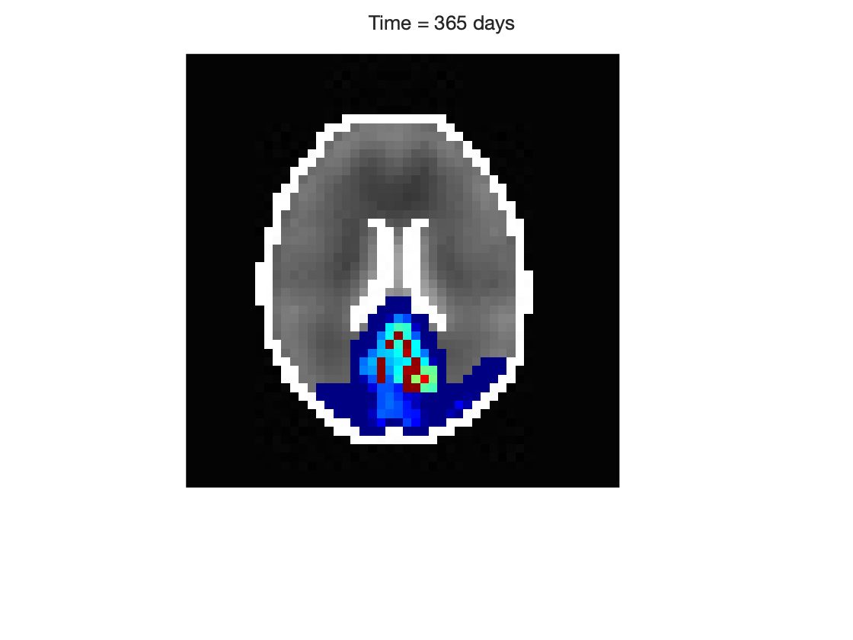
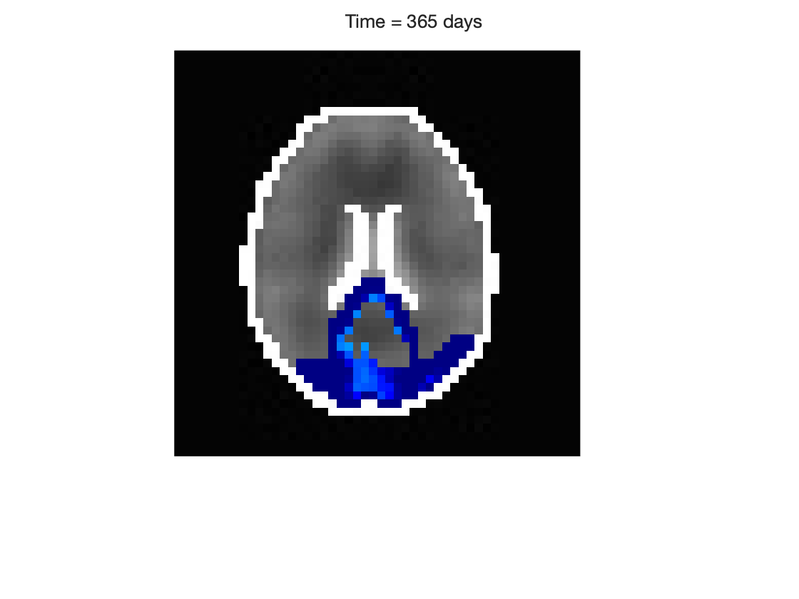
Aim 2: Proposed Work
Inverse Modeling and Model Optimization using MC Learning
Simulate 1M+ scenarios with varying parameter combinations
Learn Model Outcome vs Parameter Combinations
Predict Correct Parameter Combinations that Match Clinical Outcomes
?

Slide 10
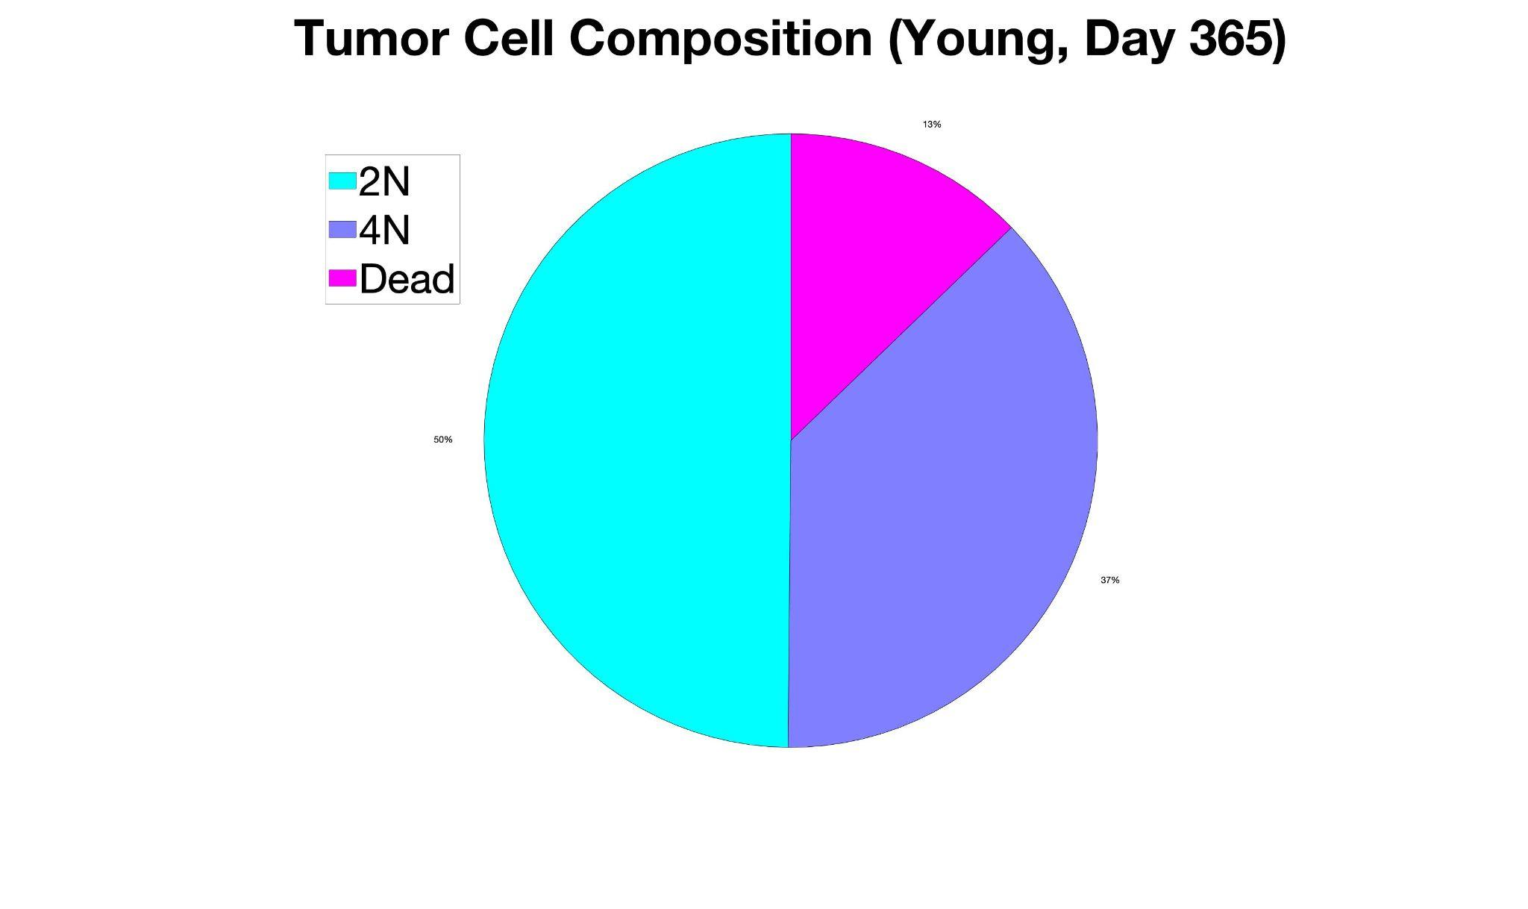
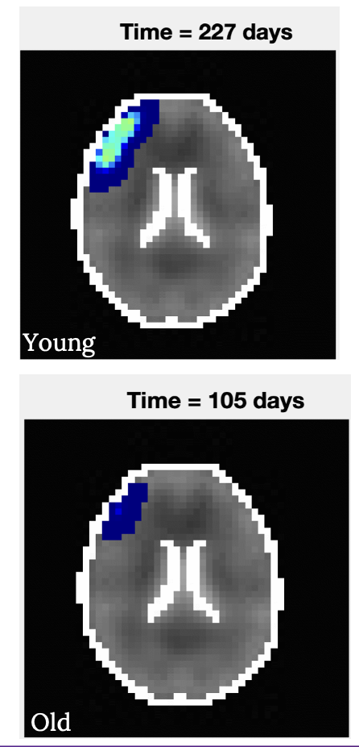
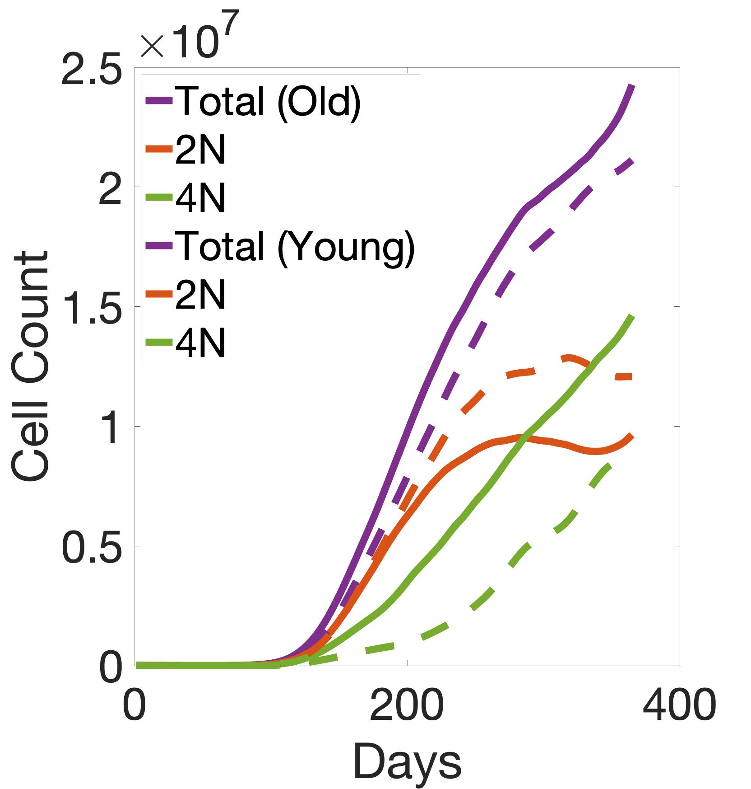
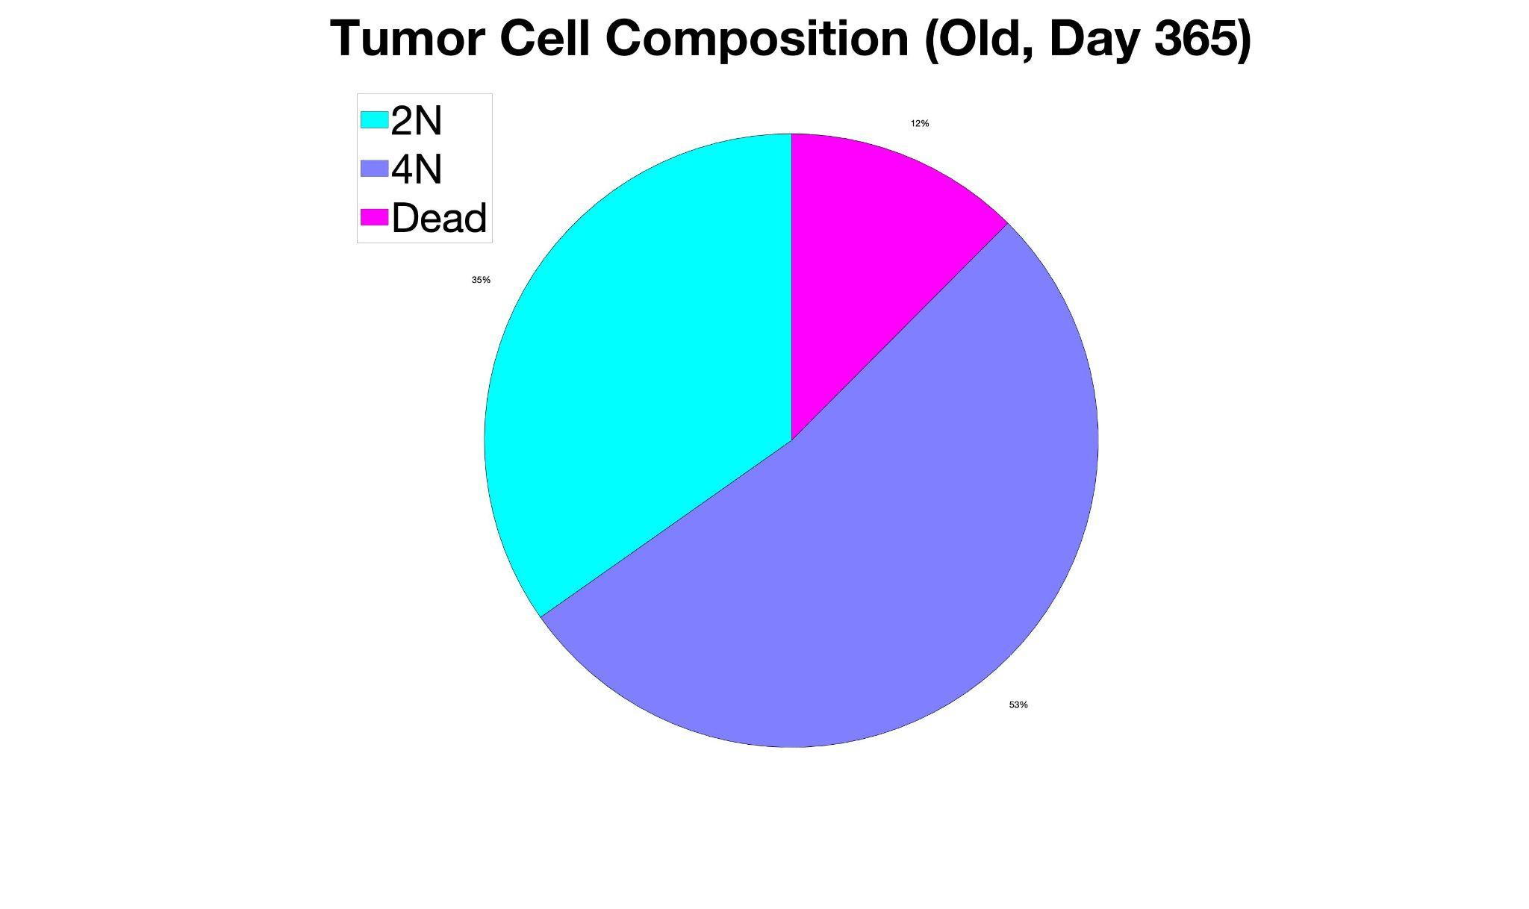
Age-based differences in the state-space of the brain
Young
Old

Slide 11
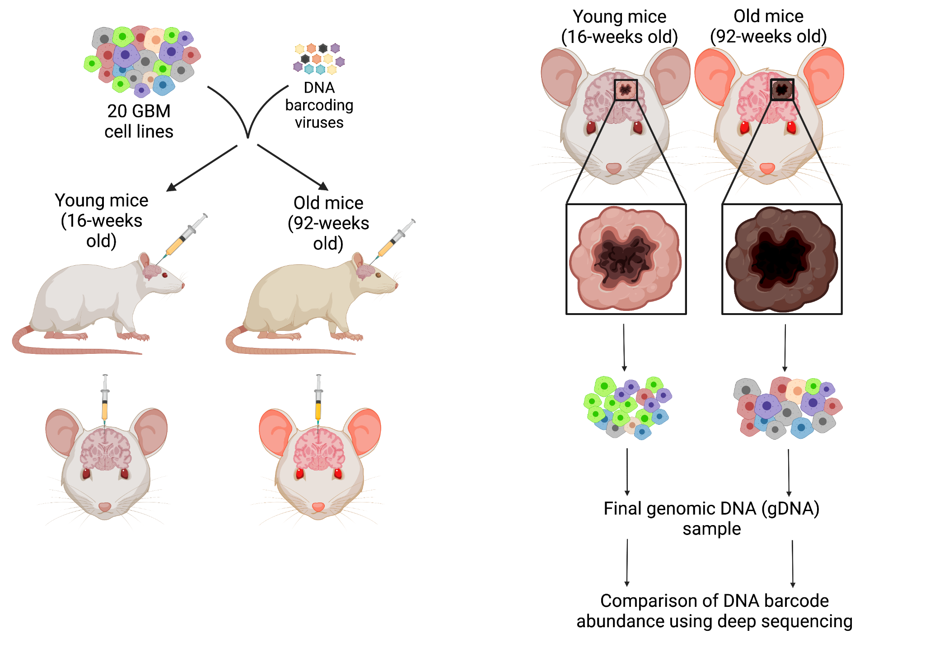
Validation of the S3MB model predictions

Slide 12
Supplementary figures
(some of the main figures will move here)

Slide 13
Proposed content for Introduction

Slide 14
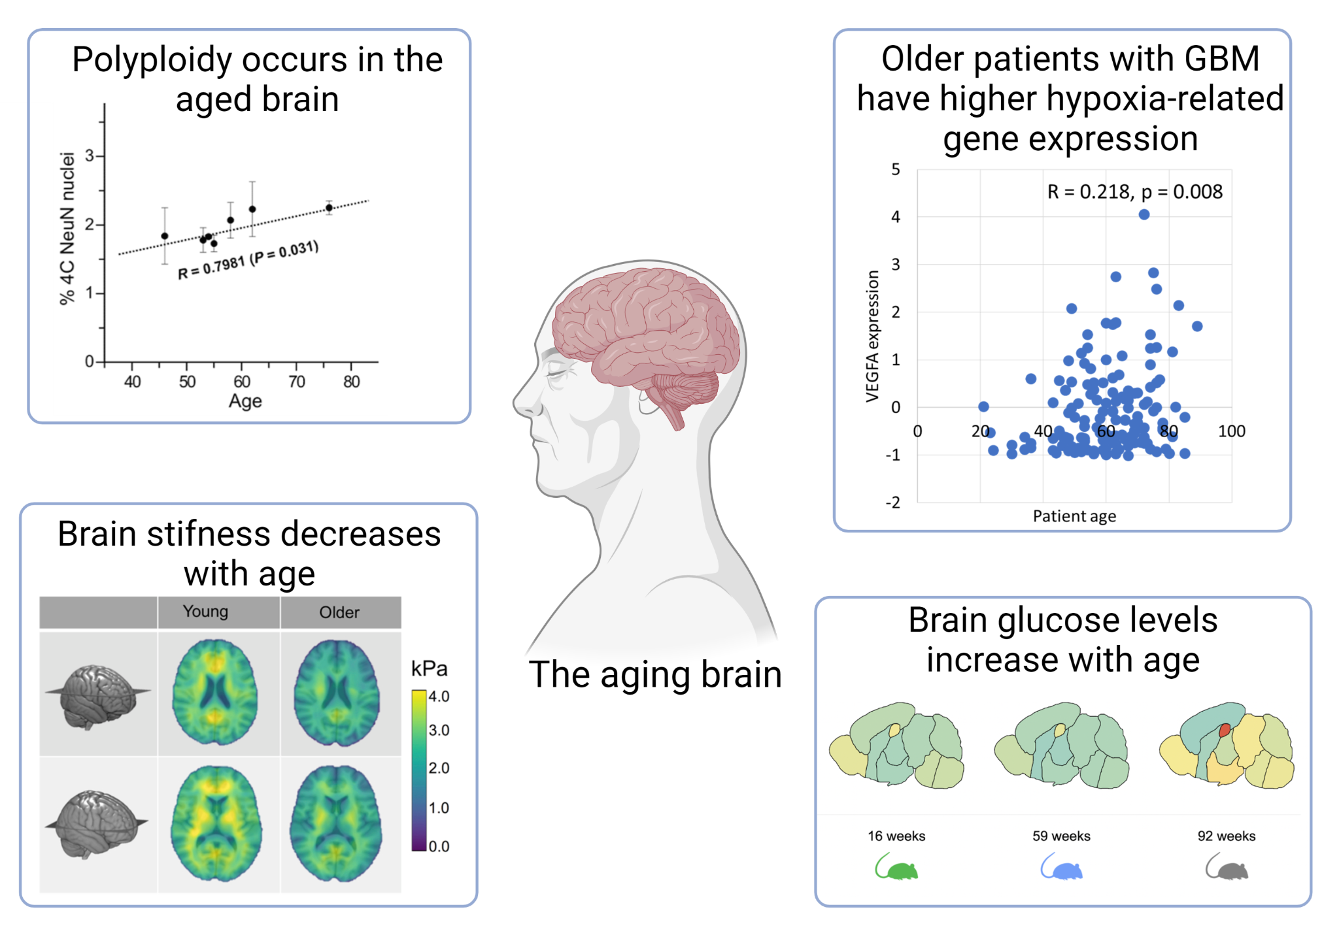
Nandakumar et al, eLife, 2021
Hiscox et al., 2018, Neurobiol Aging
Notes:
In support of this premise, polyploidy has been recently shown to increase in the brain with age and thought to be a contributor to age-related neurodegenerative diseases
supporting the idea that aging drives an environment in the brain conducive to high ploidy cancer cells to thrive.

Slide 15
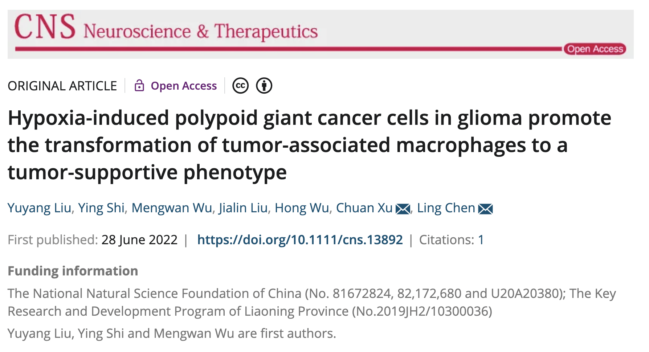
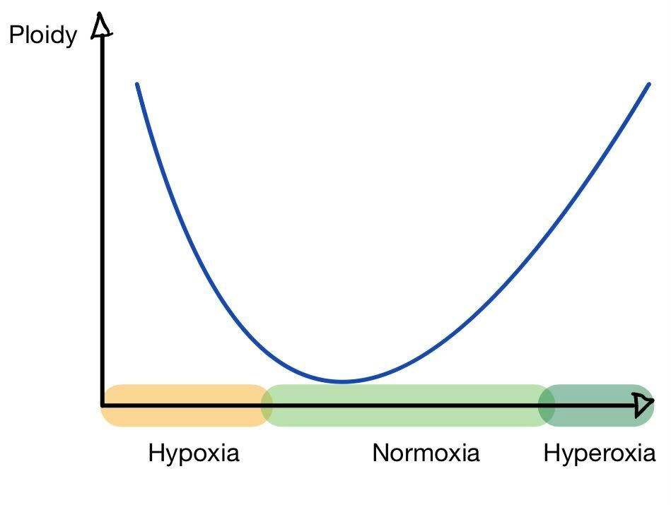
Hypothesis:
Notes:
Heterogeneity in O2 levels increases with age → more representation of extreme cases

Slide 16
Proposed content for Discussion

Slide 17
Limitations of the S3MB Model
Low spatial resolution (4mm³)
May miss small scale effects that would be captured in a full-scale PDE
Stiff boundary conditions between voxels for resources
May lead to artifacts
Currently only in 2D
Requires rigorous testing and validation

Slide 18
Backup slides

Slide 19
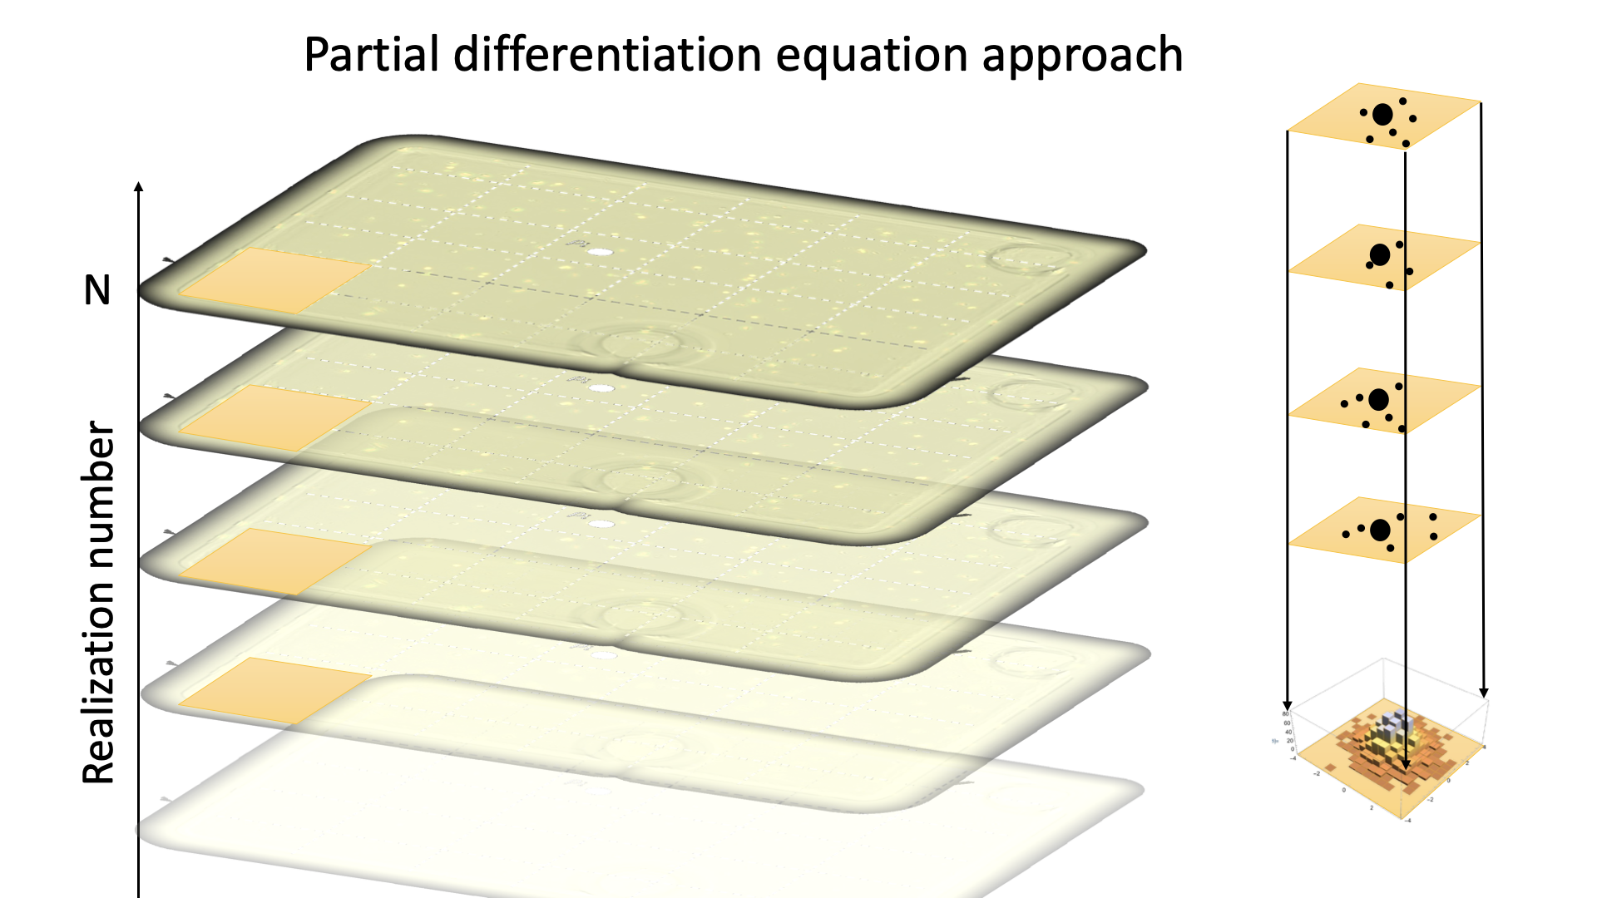

Slide 20
